Slide 1
Moscow Investment Strategy until 2025
2019
April 2018

Slide 2
Moscow Investment Strategy until 2025
Adopted in February 2014. Annually updated and discussed with the business community.
Strategic priorities
IMPROVEMENT OF INVESTMENT CLIMATE with account of urban planning and social priorities
INCREASE OF COMPETITIVE INVESTMENT AMOUNT AND SHARE in total investment in Moscow measures to support investment in the real economy development of infrastructure for innovative and high-tech industries (technoparks, special economic zone (SEZ), community centers, etc.) creation of conditions through tax and tariff policy measures
INCREASE OF PRIVATE INVESTMENT in infrastructure sectors, replacement of budget investment by private investment public-private partnership (PPP) tools involvement of the city property in economic turnover

Slide 3
SWOT Analysis of Moscow's Position
Potential business opportunities | Business conditions | Place to live
Economic, political and business center of Russia and the CIS | Availability of skilled workforce, high proportion of population with higher education | Positive dynamics of public space development
Largest sales market | Developed financial market | Leisure opportunities
Favorable geographical position, regional transport center | “Russia’s gates to the world” | Rich historical heritage
Significant and balanced city budget | Availability of an advanced IT infrastructure | High security level
Potential of "new territories" | High scientific potential | Low cost of living for foreign specialists
Increasing international competition for investors Position enhancement tools: Promotion in international rankings (FDI - Financial Times. SmartCities, PwC, Mercer, ATKearney, etc.) Positioning as an FDI-attractive global metropolis Competitive benefits for investors | Established views on Russia’s problems in the field of property rights protection and the judicial system operation Position enhancement tools: Promotion as a convenient place for business with transparent legal mechanisms Removal of administrative barriers | Need for large-scale investment in infrastructure to ensure the sustainable and integrated development of urban areas Position enhancement tools: A large-scale urban infrastructure development program (TIP) Modern urban planning approaches, best international practices (MUF)
Increasing competition for skilled labor force Position enhancement tools: Improvement of education quality, living standards and income | Limited access and increasing cost of debt financing, incl. on international capital markets Position enhancement tools: Subsidy mechanisms and access to concessional project financing | Need to improve the quality of social infrastructure and certain public services (medicine, education, etc.). Position enhancement tools: Special programs and projects (IMC, Moscow Longevity), PPP in the social sphere
Strengths
Risks

Slide 4
Investment Strategy Implementation Mechanisms
Strategic documentation system
Investment strategy Investment strategy implementation plan (for 3 years) Investment strategy implementation report (annual)
Moscow government programs
15 government programs Targeted investment program
Specialized investor organizations
City Investment Agency and other regional development institutions Interact directly with investors Support projects in priority sectors Business protection headquarters Organizations to interact with certain business categories: Innovation Agency, Industrial Development Agency, Moscow Small Business, Moscow Export Center, etc.
Unified Investment Portal www.investmoscow.ru
Information infrastructure for the interaction with investors

Slide 5
Improvement of Investment Climate

Slide 6
Improvement of Investment Climate
Reduction of business administrative barriers: regulatory framework and procedure improvement, digitalization, control and supervision reform
Introduction of regional investment standards, best practices and target models to simplify business procedures and to increase investment attractiveness.
Development of competition and establishment of transparent "game rules": Competition Development Standard, RIA and AIA, improvement of the government procurement process, promotion of high-tech product demand.
Enhancement of dialogue with business: activities of the Business Protection Headquarters - Project Office for Investment Climate Improvement, investment and business information support.
Results evaluation/monitoring:
Moscow’s position in ASI National Rating, Doing Business Rating, etc.
Notes:
2018 Moscow City Investment Agency

Slide 7
Moscow in Investment Climate Ratings
Doing Business Rating
(in the Russian rating,
Moscow accounts for 70% of values​​)
National investment climate rating (ASI)
190 countries
190 countries
85 regions
190 countries
85 regions
189 countries
85 regions
183 countries
76 regions
35
31
2
51
40
10
3
123
13
2010
2015
2016
2017
2018
2015
2016
2017
2018
Rating of the Ministry of Economic Development "Development of public-private partnership in Russia's territorial entities"
Financial Times rating "Sustainable development and FDI attractiveness rating of European cities" (FDi European Cities and Regions of the Future 2018/2019)
1st
1st
6th
place
place
place
Leading for three years in a row: from 2016 to 2018
among Eastern European cities
among European cities

Slide 8
Investment Portal: Development of Business Communication Channels
>6 m visits since 2014
2.4 m in 2018
Direct Line for Investors :
Dynamics: | 2017 | 2018
Unique visitors a day | 5,100 users | >7,000 users
Foreigners | ~20% | ~25%
Registered users | 14,020 | >20,000
Processed appeals
1,285
2017
1,539
2018
Most visited sections
Auctions
Investor's Guide
News&Events.
Industry&Innovation
City Investment Map

Slide 9
Increase of Competitive Investment Amount and Share

Slide 10
Attraction of Competitive Investment
Benefits for effective existing enterprises and new projects in the real economy.
Financial support for projects through targeted subsidies, concessional financing and guarantee support.
Localization infrastructure development (SEZ, technoparks, MTIP).
Localization promotion through long-term procurement contracts with investment commitments (offset contracts).
One stop project support
Results evaluation/monitoring:
Investment amount and structure statistics, Moscow's position in international investment attractiveness ratings (AT Kearney, FDI, etc.)
Notes:
2018 Moscow City Investment Agency

Slide 11
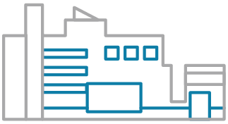
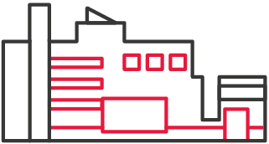
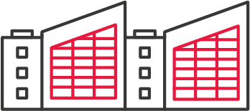
New Government Support Mechanism for Real Economy
Special status for existing enterprises
Regional tax burden reduction*
Industrial complex
Technopark
Industrial park
17-25%
Investment priority project to create
Industrial complex
Technopark
Industrial park
25%
* income tax, land tax and land rent benefits

Slide 12
Currently Supported Companies
 | TOTAL | Industrial complexes | Technoparks | Anchor residents
Companies | 85 | 44 | 34 | 7
Investment,* ₽ bn | 87.9 | 30.9 | 51 | 6
Revenue, ₽ bn | 345.7 | 237.3 | 84.1 | 24.3
Jobs,* thous. people | 103.5 | 49.8 | 49.9 | 3.8
* for the last 5 years

Slide 13
Project Financial Support: Subsidies
C&A | Interest on loans, construction and assembly work | up to ₽ 300 m a year
Equipment | Interest on loans to purchase certain types of equipment | up to ₽ 200 m a year
 | Interest under financial lease contracts | up to ₽ 100 m a year
Networks | Utility connection | 50% (no more than ₽ 100 m)
Focus: Technopark and SEZ residents, IPP status holders, export-oriented companies, etc.
For reference: ₽ 398 m of subsidies were provided in 2018 for equipment purchase
Notes:
2018 Moscow City Investment Agency

Slide 14
Additional Support for Investors
2. Preferential loans from the Moscow Fund for Industry and Entrepreneurship Support
Granting loans for a period of up to 5 years | from 10 to ₽ 200 m (no more than 70% of the project financing)
2% per annum
3-5% per annum
Technopark and SEZ residents, special IPP status holders
All industrial and scientific enterprises of Moscow
Loan objectives: purchase of equipment, working capital financing, R&D and R&T expenses, etc.
Additionally for exporters: expenses related to exhibitions, conferences, certification and patenting abroad

Slide 15
Additional Support for Investors
3. Guarantee support of Moscow Small Business Credit Assistance Fund
The largest RGO in Russia.
Expert RA “A ++” Rating, 68 partner banks and 6 leasing companies.
Provision of guarantees (additional collaterals) for loans, bank guarantees, leasing contracts | up to ₽ 100 m (no more than 70% of the total collateral need)
₽ 9.9 bn
₽ 70.3 bn
the Fund capital
guarantees granted

Slide 16
Infrastructure Development: Technopolis Moscow SEZ
207.5 ha
SEZ area
50
Residents
~5600
Jobs
₽ 16.8 bn
Investment
Special tax and customs conditions
47%
0%
Income tax*
Property tax*
Land tax*
Transportation tax*
Regional tax burden reduction
Free customs zone
Brown field projects
0%
VAT and import duties
76,800 m²
Preferential terms for land purchase and utility connection
Green field projects
7
Free utility connection
Preferential land purchase
Vacant plots
with a total area of 5.4 ha
* benefits validity period is 10 years
Notes:
Another important investment promotion tool is the Moscow Government’s work to develop special platforms for industry and high tech projects. First of all, these include the Technopolis Moscow SEZ and technoparks.
The city has created unprecedented tax conditions for project localization in the SEZ. For the SEZ residents, income, property, land and transport (regional) taxes are zeroed for a period of 10 years. In addition, the SEZ residents are exempt from customs duties and fees for the goods and equipment delivered to the special economic zone and utility connection fees within the established capacity. The overall regional tax burden reduction can reach 47%.
In addition, the SEZ residents are entitled to purchase a land plot after commissioning at a reduced price, i. e. only 1% of the cadastral value.
It should be noted that the SEZ offers an opportunity to localize both green field and brown field projects using existing production, laboratory and office spaces.
Today, more than 5,600 people are employed and 50 companies are localized in the SEZ, and the amount of investment has already reached ₽16.8 bn.
2018 Moscow City Investment Agency

Slide 17
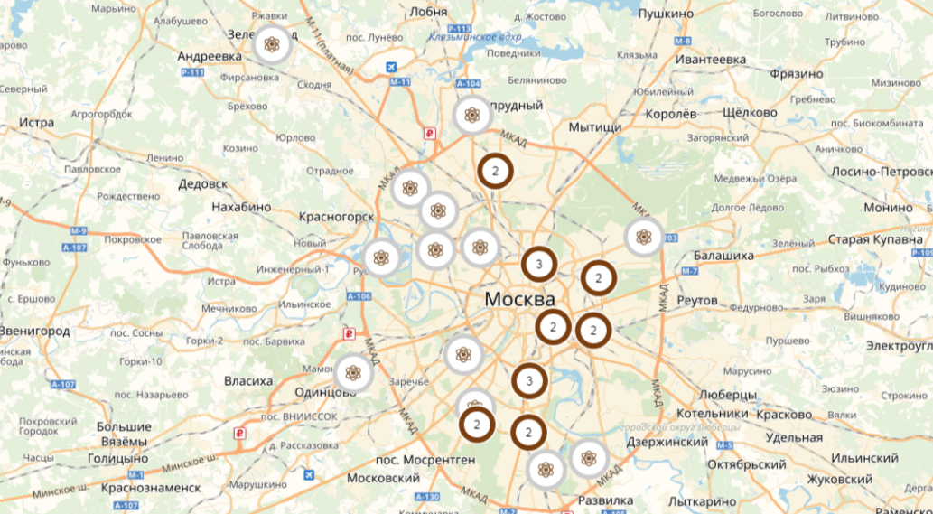
Infrastructure Development: Technoparks
34
Located all over the city:
technoparks
32
technoparks
+
2
technopolises
>1,750
residents
>49,000
jobs
Broad industry specialization:
Preferential leasing conditions
Tax benefits for anchor residents
>₽ 49 bn
of investments

Slide 18
Localization Platforms: Large-scale Investment Projects
Support measures
Examples of ongoing projects
land lease without bidding
Printing technopark
₽ 17 bn
is total planned volume of investments
57,000 sq. m
Moscow Packing Center JSC
North-West Administrative District, Proyektiruyemy pr. 727, 24, bld. 1
30 land plots
are approved by UPLC
Manufacture of stamped and assembly products for automotive industry
>500,000 sq. m
is the maximum possible area of ​​capital construction
45,000 sq. m
AAT JSC
Southern Administrative District, Proyektiruyemy pr. 5307

Slide 19
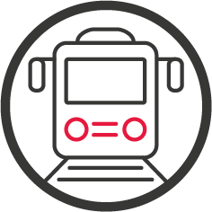
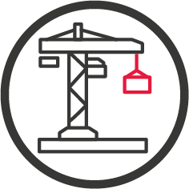
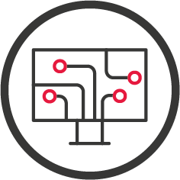
Offset Contracts
New localization support tool
Possibility of concluding long-term government contracts with the supplier's counter obligations on investments (offset) is stipulated in 44-FZ (open tender).
Key contract conditions
10 years
up to
contract duration
>₽ 1 bn
investment in creation, modernization and/or development of production
Promising fields:
Russian-manufactured products to be purchased

Slide 20
Investment Project Support
One stop investor support free services for investors | Moscow City Investment Agency Moscow Investment Portal www.investmoscow.ru
Legal and organizational support specialized business services | Business Protection Headquarters Thematic portals: www.zakupki.mos.ru, www.mbm.ru, www.imoscow.mos.ru, etc.

Slide 21
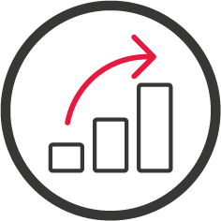
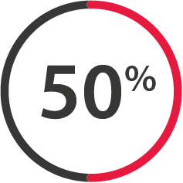
Investment Dynamics and Structure
+80%
investment growth
in 2011 - 2017
in comparable prices
against 2010
₽ bn
~50%
Moscow's share in accumulated FDI
in Russia
 | 2010 | 2017 | Growth
Total | 100 % | 100 %
Industrial and high-tech sector *** | 13.8 % | 22.0 % | +8.2 pp
Transport | 17.8 % | 25.8% | +8 pp
* assessment according to the Moscow socio-economic development forecast for 2019 and a planned period of 2020 and 2021
** target value of Investment in fixed assets in 2025
*** the industry and high-tech sector includes manufacturing, communications, research and development

Slide 22
Increase of Private Investment
in Infrastructure Industries

Slide 23
Priorities of Moscow PPP Policy
Support of investment initiatives regardless of the scale (including SMEs).
Not only attracting financial resources, but also attracting competencies is in focus.
Using best practices and international experience to solve specific problems the city is facing.
Key drivers for attracting private investment in infrastructure:
A large-scale urban infrastructure development program
Moscow megaprojects - creation of basic conditions for private investment projects
Multiplicative effects - private and city investment synergy
Results evaluation/monitoring:
PPP projects/concluded PPP contracts statistics, Moscow’s position in the PPP development rating of Russian regions
Notes:
2018 Moscow City Investment Agency

Slide 24
Development of PPP Mechanisms
> ₽ 850 bn
INCLUDING:
₽ 65 bn Concession projects
₽ 434.8 bn Life Cycle Contracts (LCC)
₽ 232.4 bn Long-term contracts with an investment component
₽ 113.8 bn Corporate PPP
₽ 16.8 bn Real estate lease with Investment commitments
volume of PPP project contracts from 2013 to February 2018
1st place
in PPP development rating of Russian regions
1st
place
3d place
13th place
2013
2015
2016/2017/2018

Slide 25
Moscow Megaprojects as Investment Driver
₽ 1.6 tn
>70%
Moscow TIP for 2019-2021
Transport infrastructure
Development of Moscow Central Circle (MCC)
₽ 1 of the city investment ~ ₽ 3 of private investment
Moscow Housing Relocation Program
International Medical Cluster (IMC)
​​Budget investment to create conditions for private and PPP projects

Slide 26
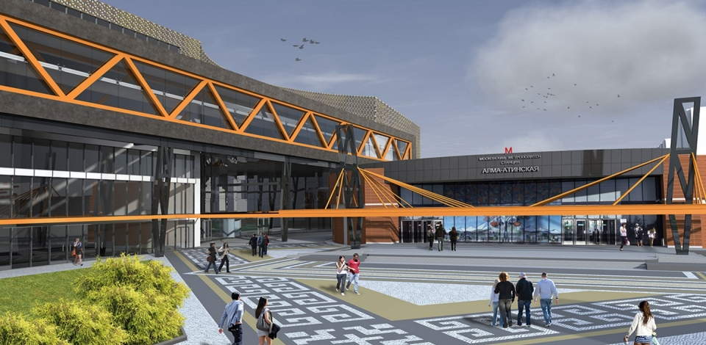
Construction of Transport Hubs (TH)
at metro and urban railway lines and stations, both existing and under construction
≈14 m sq. m
TH town planning potential
>₽700 bn
estimated private investment in TH
16 TH
already transferred to investors
₽113.8 bn
expected capital expenditures of private investors
1.45
permitted capital construction volume
m
sq. m

Slide 27
Preferential Lease with Investment Commitments
Project scope
City premises repair/restoration at the investor's expense with the subsequent operation thereof as social and cultural facilities (preferential lease for 20 and 49 years)
PPP principle
Market rent rate (bidding) before commissioning (repair/restoration)
₽1 per m2 a year after commissioning (investment phase completion)
>₽5 bn
of private investment
113
ongoing projects
57
facilities opened/restored

Slide 28
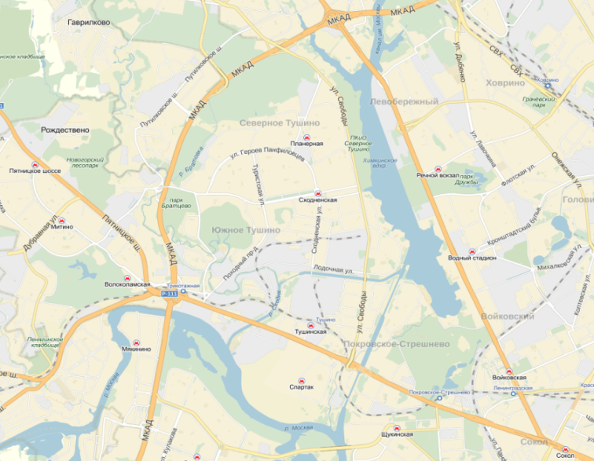
New Transport Concessions: "Cable Way"
Creation of a modern cable way between the Skhodnenskaya and Rechnoy Vokzal metro stations at the expense of a private investor
₽4 bn
investment
(no city investment)
45 min
45 min
Khovrino (2016)
Khovrino (2016)
Planernaya
Planernaya
7 min
Rechnoy Vokzal
Rechnoy Vokzal
2.5 years
construction time
Skhodnenskaya
Skhodnenskaya
7 min
Vodny
Stadion
Vodny
Stadion
Tushinskaya
Tushinskaya
45 min
Voykovskaya
Voykovskaya
Project payback
Spartak
Spartak
Sokol
Sokol
Schukinskaya
Schukinskaya
The facility payback and maintenance by the investor through direct ticket sale, advertising and commercial space use

Slide 29
Thank You for Your attention!
We invite You to invest in Moscow!
Moscow City
Investment Agency
Government of Moscow www.investmoscow.ru
investmoscow@mos.ru

